Slide 1
Advanced Programming
END SEMESTER PROJECT
Submitted to: Dr. Sidra Sultana Submitted by: sarah tayyab (212902)
Tatheer Zahra (211972)
Zoha ahmed (213901)

Slide 2
FIND MY FRIENDS Application

Slide 3
Languages/TOOLS used:
React-Native-Maps
Scaledrone React-Native-Client (RealTime Backend/API)

Slide 4
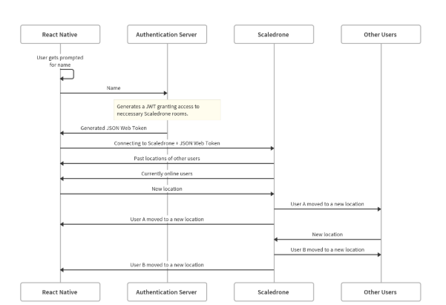
This is how our app will work:

Slide 5
The project is divided into two independent parts:
A React Native app.
An authentication server. The server authenticates a joining user and controls which parts of Scaledrone they can access.

Slide 6
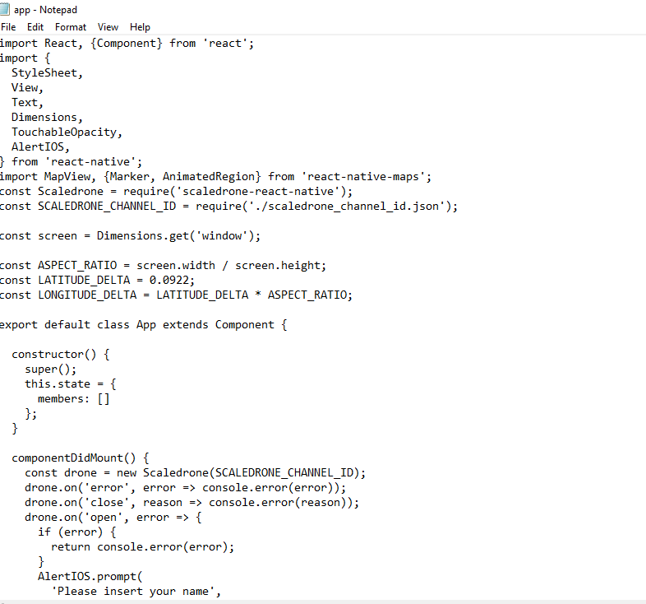
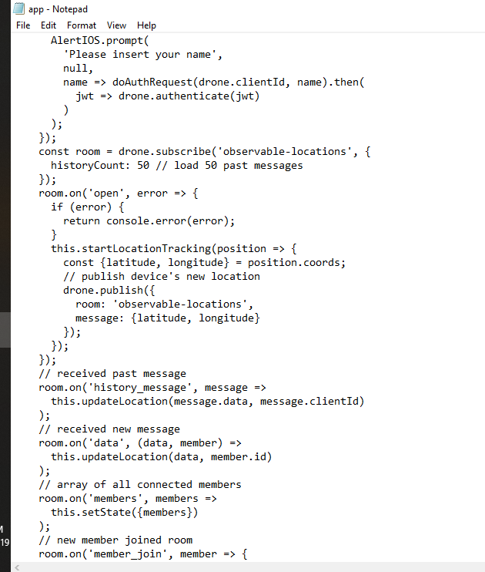
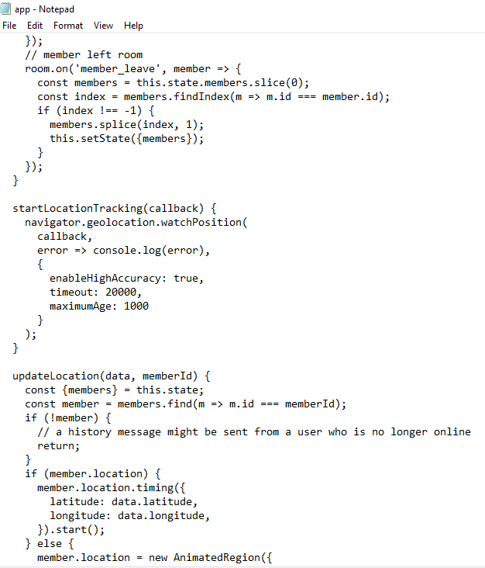
React Native app:
Code for APP.JS:

Slide 7
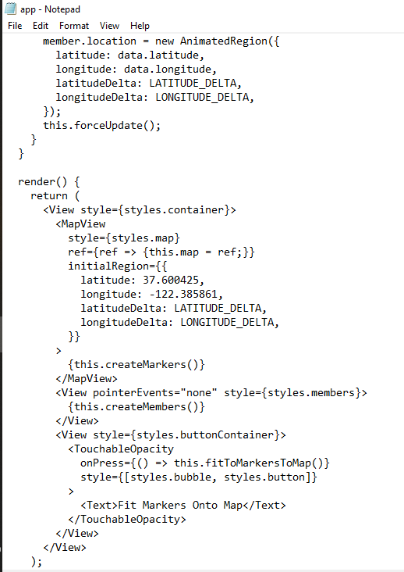
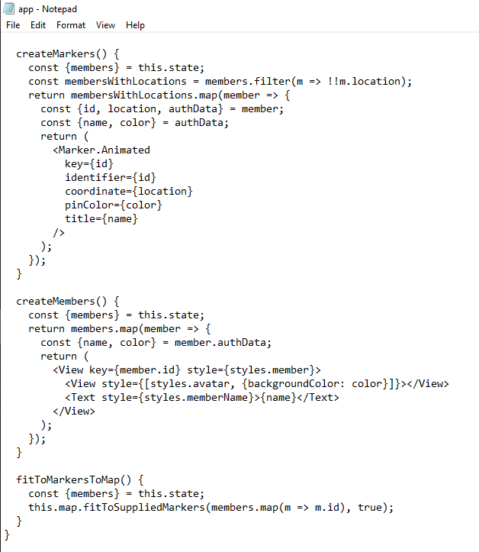
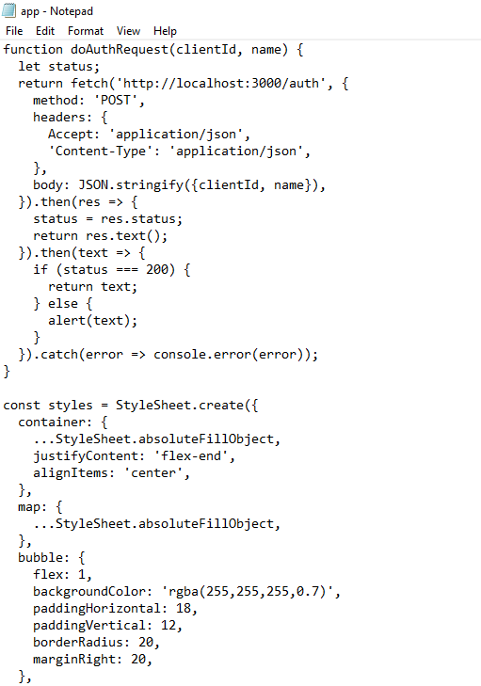
React Native app: Code For APP.JS:

Slide 8
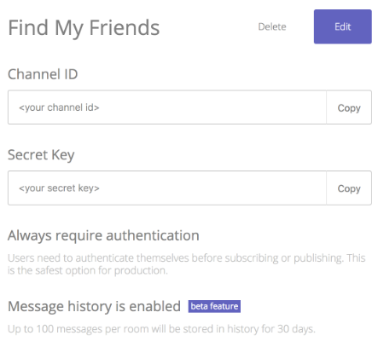
An authentication server. Connecting to Scaledrone:
Just go to scaledrone.com, sign up and create a new Scaledrone channel.
Within the Scaledrone channel settings, enable the message history and set the authentication setting to Always require authentication.

Slide 9
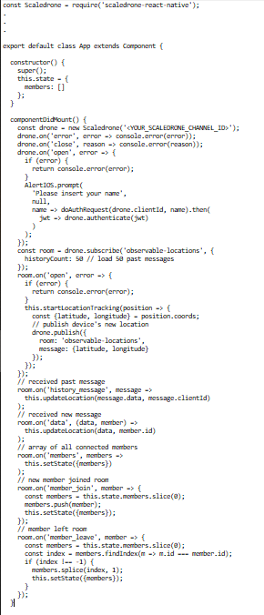
An authentication server. Connecting to Scaledrone:
Code:
Install Scaledrone:
npm install scaledrone-react-native –save

Slide 10
Rendering the online users list:
Rendering the map markers:
createMarkers() { const {members} = this.state; const membersWithLocations = members.filter(m => !!m.location); return membersWithLocations.map(member => { const {id, location, authData} = member; const {name, color} = authData; return ( <Marker.Animated key={id} identifier={id} coordinate={location} pinColor={color} title={name} /> ); }); }
createMembers() { const {members} = this.state; return members.map(member => { const {name, color} = member.authData; return ( <View key={member.id} style={styles.member}> <View style={[styles.avatar, {backgroundColor: color}]}/> <Text style={styles.memberName}>{name}</Text> </View> ); }); }

Slide 11
Fitting markers onto the screen:
Authenticating the connection:
fitToMarkersToMap() { const {members} = this.state; this.map.fitToSuppliedMarkers(members.map(m => m.id), true); }
function doAuthRequest(clientId, name) { let status; return fetch('http://localhost:3000/auth', { method: 'POST', headers: { 'Accept': 'application/json', 'Content-Type': 'application/json', }, body: JSON.stringify({clientId, name}), }).then(res => { status = res.status; return res.text(); }).then(text => { if (status === 200) { return text; } else { alert(text); } }).catch(error => console.error(error)); }

Slide 12
Authentication Server
const express = require('express'); const jwt = require('jsonwebtoken'); const colors = require('./colors'); const bodyParser = require('body-parser'); const cors = require('cors'); const app = express(); app.use(bodyParser.json()); app.use(cors()); app.post('/auth', (req, res) => { const {clientId, name} = req.body; if (!clientId || clientId.length < 1) { res.status(400).send('Invalid ID'); } if (!name || name.length < 1) { res.status(400).send('Invalid name'); } const token = jwt.sign({ client: clientId, channel: '<YOUR_SCALEDRONE_CHANNEL_ID>', permissions: { "^observable-locations$": { publish: true, subscribe: true, history: 50, } }, data: { name, color: colors.get() }, exp: Math.floor(Date.now() / 1000) + 60 * 3 // expire in 3 minutes }, '<YOUR_SCALEDRONE_CHANNEL_SECRET>'); res.send(token); }); app.listen(3000, () => console.log('Server listening on port 3000'));

Slide 13
Running the application
cd server-dir
node index.js
Run you emulator
Then Run: node random_movement.js

Slide 14
Features already present in the application:
Locate geographical position of a new user
Using maps, finds all your friends near your location on the map
Store location of each already member present
When a user changes position, find the new location and save it

Slide 15
Features that we added:
We converted the app for an android system, it was originally designed for IOS

Slide 16
Problems:
Emulator was hard to setup
Live reload often caused issues
When adding native code warnings aren't clear that a new build is needed.
Maintaining track of files, know the current directory we are in was also hard

Slide 17
Future Work:
We can expand the project for user’s that are not in our friends list to suggest new friends.
We can also add a new feature that enables us to mark some friends as favorites so their location comes at the top
A Notification To your friends whenever you find them on a map

Slide 18
Conclusion:
it helps you locate your friends, letting you know whether or not a work fellow has arrived yet or if they have skipped the day. The project helped us see some basic differences between iOS coding and android coding. We also learned about scaledrone which was a new thing for us. We also learned how to make use of an existing piece of code for a new project.

